Slide 1
Decentralized Healthcare Records Management Blockchain-based system for secure and private sharing of medical records among patients, doctors, and hospitals.
Haresh kumar
Tarun Prasad
Loknath
Ajay I

Slide 2
Problem Statement
Medical records today are stored in centralized databases prone to breaches.
Patients have limited control over who accesses their data.
Data sharing between hospitals, doctors, and labs is inefficient and insecure.
Need for a secure, transparent, and privacy-preserving solution.

Slide 3
Proposed Solution
A decentralized healthcare records management system powered by blockchain.
Patients own and control their medical records.
Doctors & hospitals can access data securely with patient consent.
Immutable, transparent, and auditable records ensuring trust & accountability.

Slide 4
Features of the System
Patient-Centric: Patients decide who can view their data.
Blockchain Security: Tamper-proof and immutable storage.
Interoperability: Access across multiple hospitals and systems.
Smart Contracts: Automated consent and access management.
Privacy: End-to-end encryption for sensitive health records.

Slide 5
System Architecture
User Roles: Patient, Doctor, Hospital, Admin.
Blockchain Layer: Stores hashed medical record references.
Storage Layer (IPFS/Cloud): Stores encrypted health records.
Smart Contracts: Control permissions and access.
Mobile/Web App: User-friendly interface for patients & doctors.

Slide 6
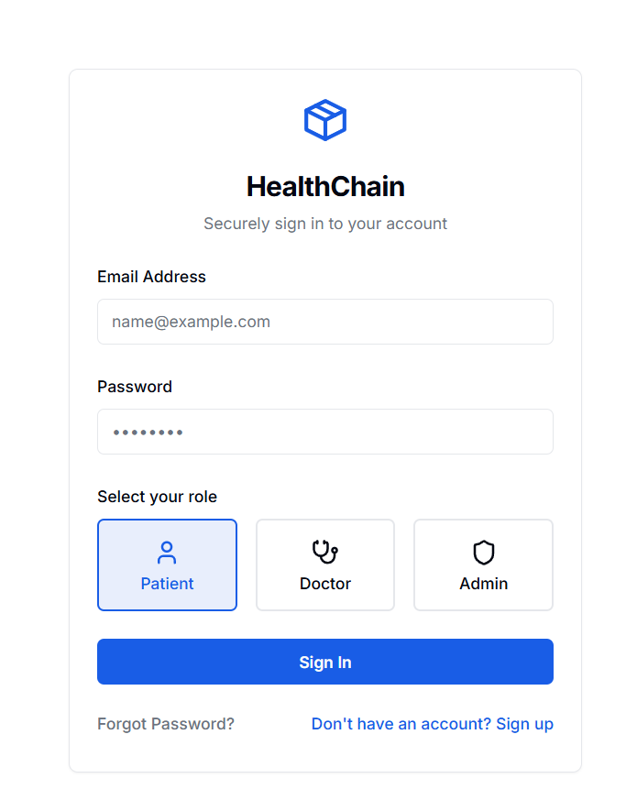
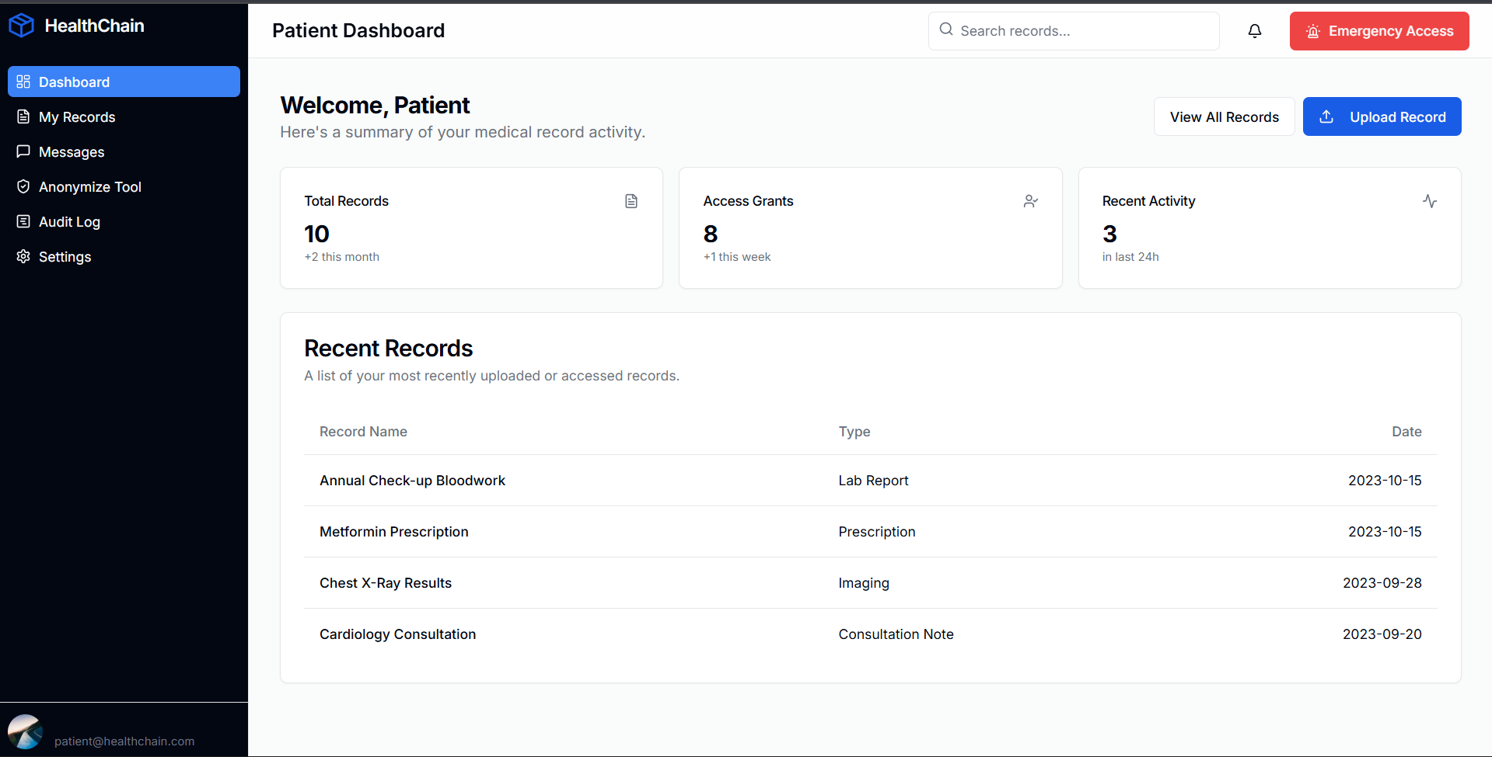
Output

Slide 7
Benefits & Impact
For Patients: Full control, privacy, secure lifelong records.
For Doctors/Hospitals: Instant access, reduced paperwork, improved trust.
For Healthcare System: Better interoperability, reduced fraud, cost-efficient management.
Long-Term Impact: Building a transparent, patient-first healthcare ecosystem.

Slide 8
Future Scope & Conclusion
Integration with government health schemes (e.g., Ayushman Bharat).
Support for AI-driven health analytics.
Multi-language mobile support for rural adoption.
Scope to integrate wearable devices & IoT health trackers.
Conclusion: A decentralized, secure, and patient-centric healthcare system for the future.

